Slide 1


TooHealthy
SUSTAINABILITY
ZUBABEZA TEAM
JUNCTION 2019

Slide 2
PROBLEM
People with strict diet have to spend much time to find out if they can eat this food or not

Slide 3
3-step solution
Your characteristic
Shop visiting and barcode scanning
Your characteristic

Slide 4
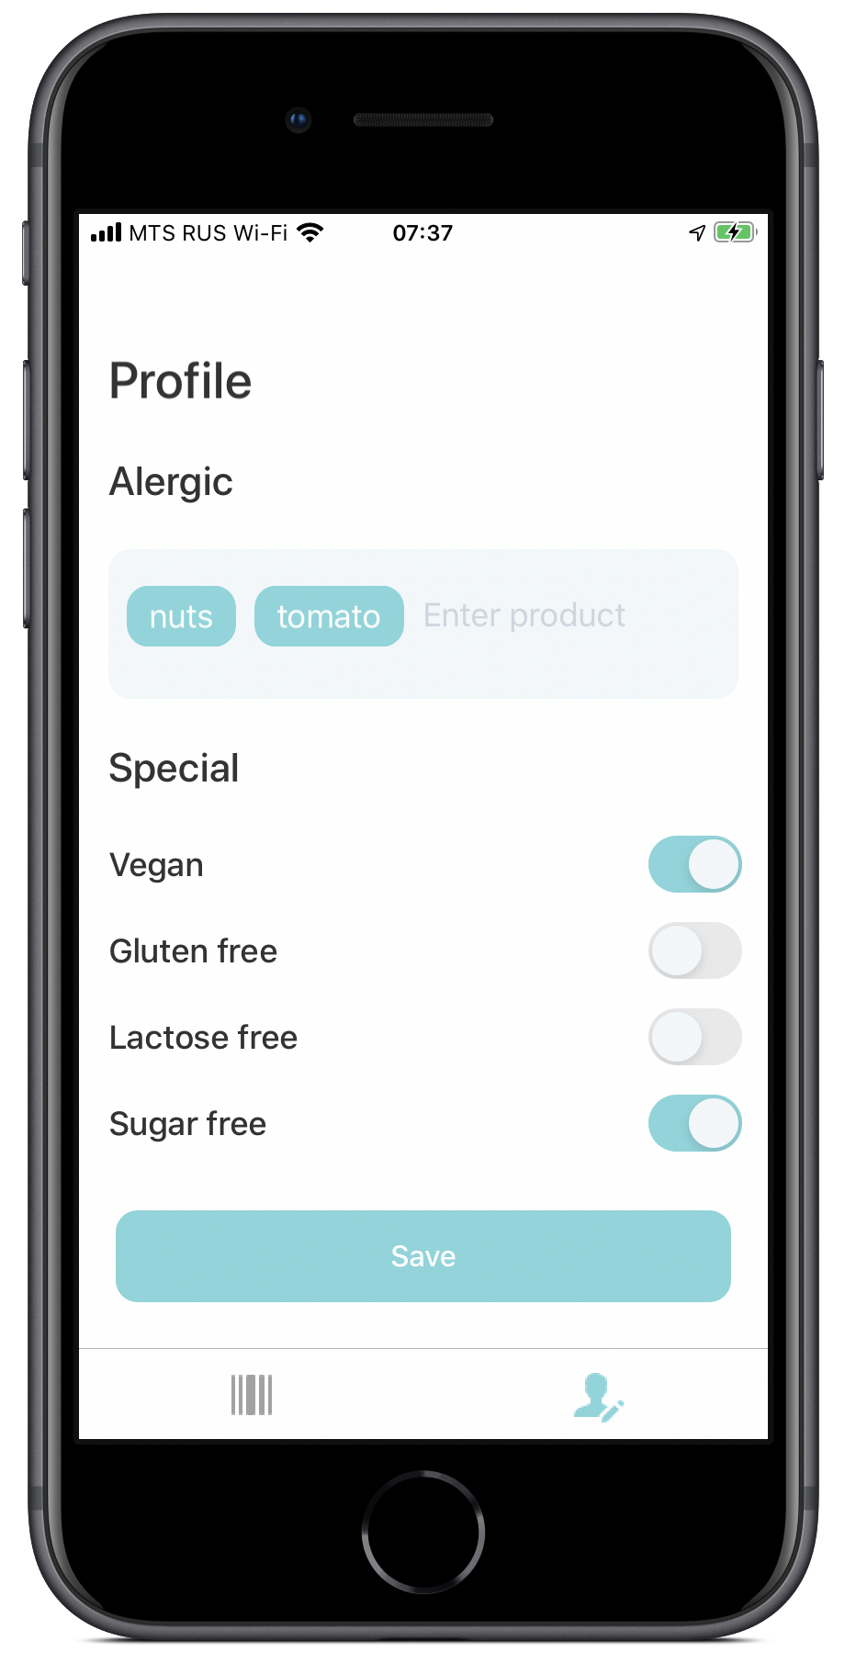
First step
Fill out a profile

Slide 5
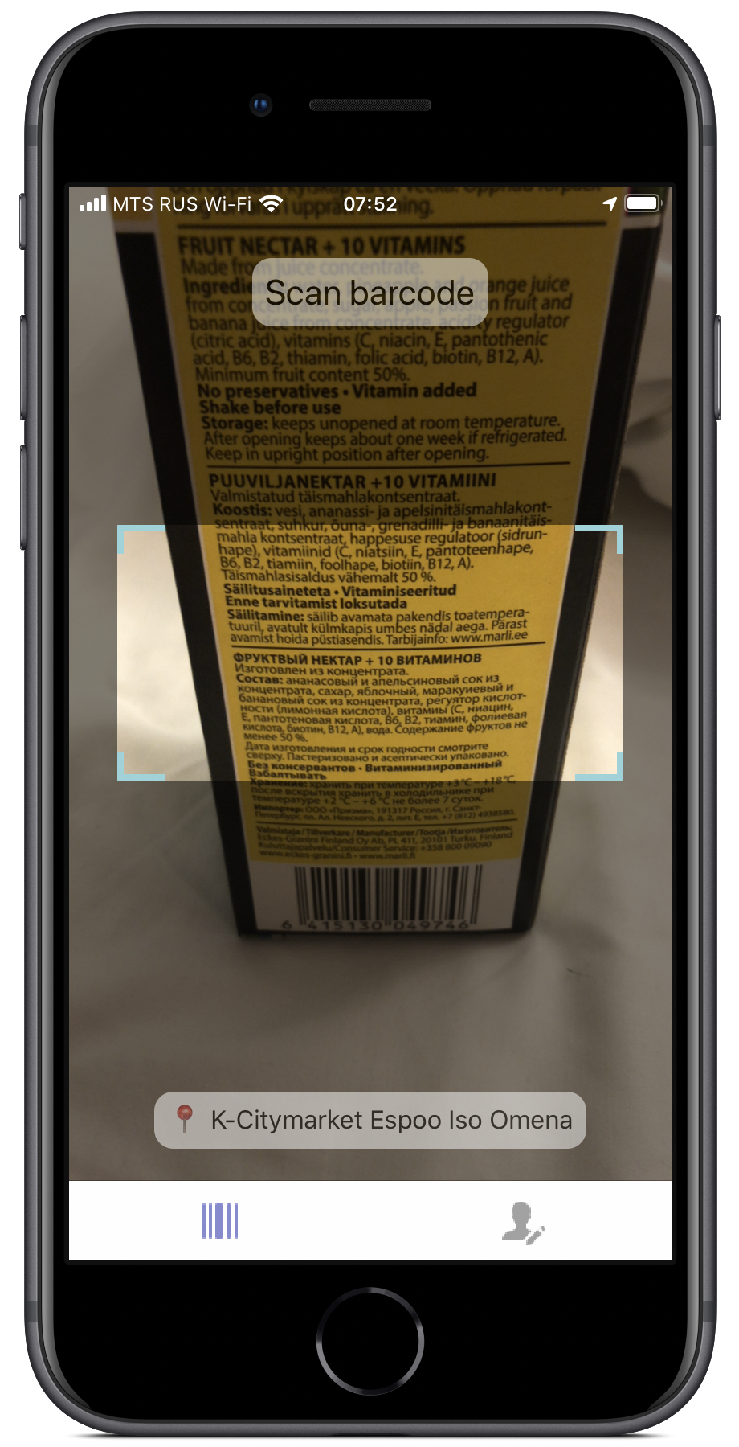
Second step
Scan barcode

Slide 6
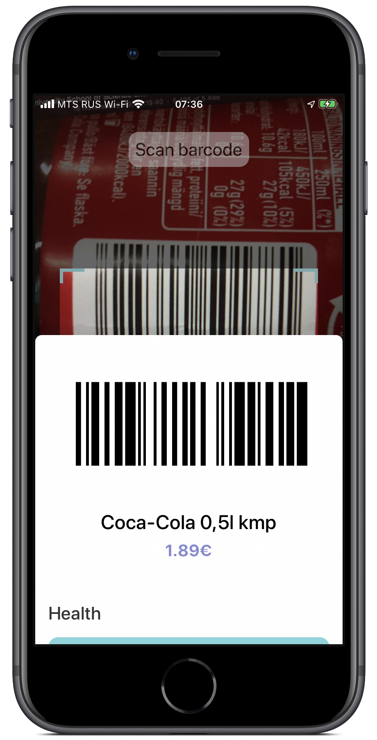
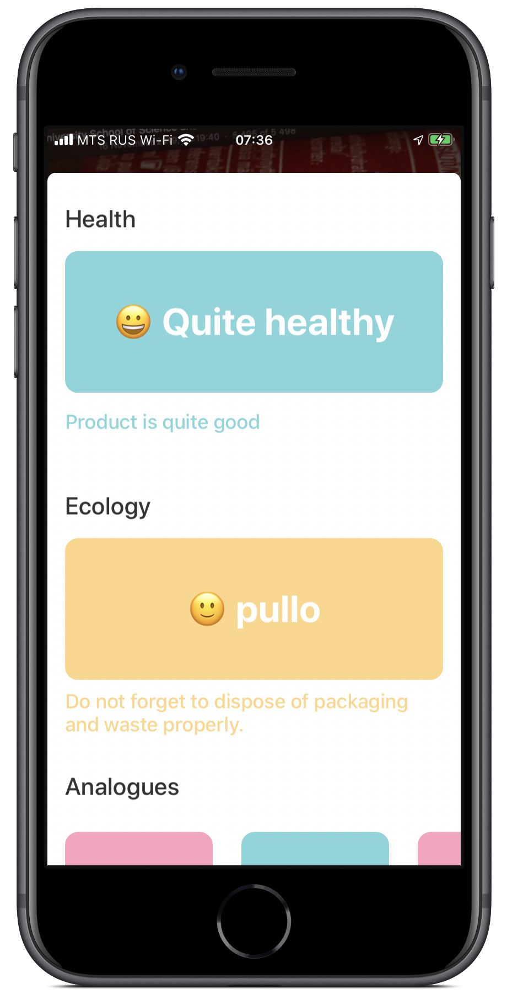
Third step
View info

Slide 7
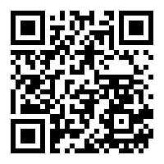
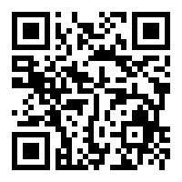
iOS app
backend

